Slide 1
Foundations of Inclusive Education
The ABCs of Inclusion

Slide 2
3 Outcomes for all Students in Inclusive Education
Knowledge / Skills
Membership
Relationships

Slide 3

Definition of Inclusion
Inclusion is defined as the philosophy and practice of educating all students in regular classrooms, including those with the most significant disabilities. All students are valued for who they are and are seen as having potential to grow and develop academically and socially. Supports are provided to enable both students and teachers to be successful.

Slide 4


Topics covered
Definitions
Handicapism
Evolution of special education and key concepts
Language and labelling
Funding categories
Student diversity
Supportive classrooms
(Dis)ability awareness
Education Assistant role

Slide 5
Inclusion is Not…
Mainstreaming or integration
Segregated programs
Physical placement (proximity)
Placement with younger peers
So little involvement with teacher, peers or class that student is regarded as a “visitor”
Relating only to adult support personnel
A program
A privilege

Slide 6
Inclusion is Not…
“Dumping” rather than planning
Underestimating the effectiveness of explicit instruction; focusing on activities rather than outcomes
1:1 instruction or reliance on education assistants
Assuming that sitting quietly is an appropriate alternative to participation
Assuming the educators need little expertise or education to effectively support students
Working alone

Slide 7
Inclusion is not about placement
Inclusion is...
  A philosophy
  A planning approach
  An instructional approach
  An attitude and a value
  NOT A PLACE

Slide 8

Activity: The ABCs of Inclusion

Slide 9

Creating an class ABC book
Select a letter
Think of a word that starts with that letter that says something about Inclusion
Create a sentence or phrase using the word
Draw an image

Slide 10

ABC page format

Slide 11
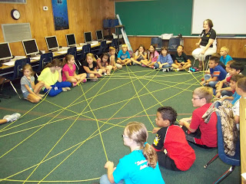
Closure: Yarn Web
One new thing I learned is....
One personal quality or belief I bring to the role of Education Assistant is...

